Slide 1



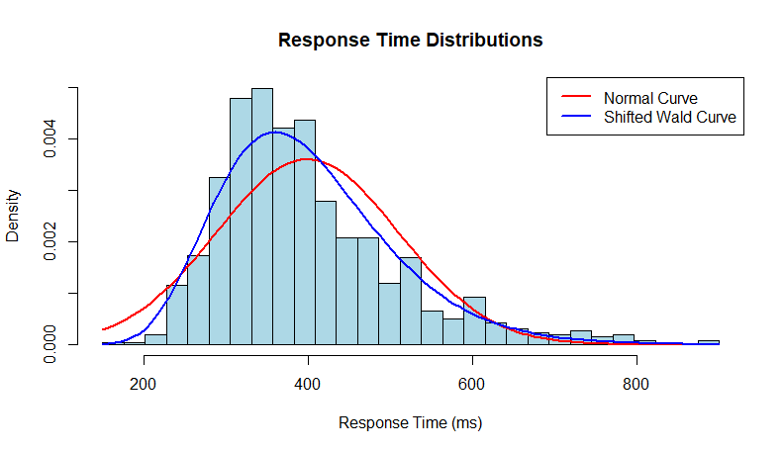
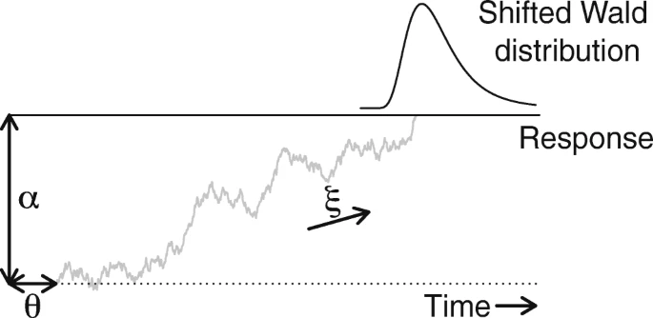

Utilizing Response Time Assessments of Cognitive Function: The First Step in Understanding Cancer-Related Cognitive Impairment
B.L. Scheuler¹, J.W. Houpt¹, and D.C. Hughes²
¹The University of Texas at San Antonio ²The University of Texas Health Science Center at San Antonio
Introduction to CRCI
So what’s the problem?
Rate of CRCI incidence ranges from 15%-75%, depending on the study
Qualitative and quantitative measures frequently lack correlation
Across 34 articles, 61 different assessments were utilized, all meant to represent CRCI
Our measurements are not consistently capturing CRCI.
The Planned Study
According to the World Cancer Research Fund International, there were 18.1 million new cancer cases diagnosed worldwide in 2020. At the same time, the average 5-year cancer survival rate has climbed to 68%. While the increases in survivability are encouraging, there is a growing need to address patient quality-of-life during and after cancer. One of the many symptoms impacting quality-of-life is cancer-related cognitive impairment (CRCI), commonly referred to as “chemo-brain.” This form of dysfunction can be debilitating, and patient experiences often include:
Forgetting how to complete common tasks
Getting lost on familiar routes and other directional difficulties
Inability to multitask
Forgetting words, or struggling with sentence formation
These symptoms often have deeper ramifications, including loss of social relationships, difficulties when returning to school or work, medication nonadherence, and lower survival rates. As these ripple effects can drastically impact a patient’s quality-of-life, there has been a surge to understand what is causing CRCI, so we can create treatments (or even prevent) this dysfunction.
In a collaboration with the HEAL team at UT-Health San Antonio, we plan to evaluate CRCI throughout a 6-month holistic, therapeutic yoga intervention. This project will be split between San Antonio and Laredo, Texas, with 35 Latino and 35 non-Latino breast cancer survivors. Throughout this study, the cancer survivors will receive dietary counseling and daily psychosocial support. At intervals throughout the 6-months, multiple facets of cancer survivor quality-of-life will be measured, including spiritual health, cognition, FitBit activity, physical functioning, body image, stress, motivation, social support, dietary choices, and inflammation biomarkers. This holistic approach is designed to evaluate the efficacy of a culturally-sensitive intervention, while assessing the multi-dimensional changes in survivor quality-of-life.
Response Time Modeling
While neurocognitive tasks in CRCI research commonly measure response times, past analyses have relied on mean-based assessments. As Schwarz (2001) explained, “the decision to initiate and execute a specific overt response does not arise holistically, in an all-or-none fashion, but is rather preceded by a stage during which response-related information gradually accumulates over time.” How could assessing this accumulation of information improve our understanding of CRCI? By utilizing accumulator models to analyze the distribution of response times, we can gain more information than available when relying on averages.
The Cognitive Assessments
Attention Network Test (ANT)
Fan et al. (2002)
Evaluates three areas of attention (alerting, orientation, and executive control)
Dual-N-Back Task
Heathcote et al. (2015)
Provides a measure for workload capacity
Open-Source Anticipated Response Inhibition (OSARI) Task
He et al. (2022)
An alternative to stop-signal delay tasks for measuring executive control
PROMIS Functional Assessment of Cancer Therapy- Cognitive Function (FACT-Cog) Short Form
Henneghan et al. (2023)
One of the most commonly used self-report measures of CRCI
Associated with changes in multiple biomarkers, including IL-6, IL-4, and IL-1β
The UTSA team will utilize response time modeling to longitudinally assess changes on the three response time tasks for each participant. Our focus is to evaluate the effectiveness of the intervention on cognitive outcomes while developing our understanding of the relationship between CRCI and inflammation.
Pathways to Damage
Better Representation of Data
INFLAMMATION
Treatment Regiment
Tumor Development
Structural Damage
Patient Characteristics
DNA Damage
Impaired Neurogenesis
Compromised Neurotransmission
Over the last 20 years, research has shifted to a focus on how inflammation may be the underlying factor driving the multiple components causing CRCI.
Meaningful Parameters
In one example, the shifted-Wald model, each of the three parameters (shift, drift rate, and response threshold) are informative of unique, underlying cognitive processes.
Results have varied, as many biomarkers can serve as both pro- and anti-inflammatory agents, but the signaling proteins most frequently associated with increased CRCI are:
interleukin (IL)-6, IL-2, IL-4, IL-10, IL-1β
interferon-alpha (IFN-α)
tumor necrosis factor-alpha (TNF-α)
brain-derived neurotrophic factor (BDNF)
Possibly: amyloid beta and tau
Considerations
Response time modeling approach provides a crucial avenue to improve CRCI assessment analysis. Future studies can focus on many components of implementing this approach, including:
Developing a reference point for this population
Establishing any differences for current cancer patients
Assessing how individuals vary in cognitive abilities before an intervention
Evaluating which CRCI tasks can be most benefited by a modeling approach
Determine the impact of compensation tactics on evaluating CRCI
Though challenging, there is great potential for improving CRCI measures by changing our approach.
Why It Matters
Cognitive Domains
Utilizing a response time modeling approach is not the only step we will need to take to understand CRCI, but it is still an important step. It remove the vagueness of a change in average response time, and provides a way to map theory onto empirical data.
The experience often varies between patients, but common cognitive domains impacted by CRCI include:
Attention/ Orienting | Visuospatial Reasoning
Executive Control | Psychomotor Dexterity/ Speed
Working Memory | Verbal Fluency
For references, contact information, and more, please see QR code. Questions, concerns, or ideas are welcome.
Theory
Response Time Modeling
Data
We can do better, so we should do better.

